Slide 1

FDS
PROJECT
Shayan lodi-27002
Faariha Atiq-26993
Kanza Rehan-27182
Uzair Arif-27184

Slide 2

Table of
CONTENTS
01
02
03
04
Business Problem
Composition of
Data
Preprocessing Techniques
Logistic Regression
05
06
07
08
Decision Tree
Naive Bayes
KNN
SVM
09
ANN

Slide 3


BUSINESS PROBLEM
Predicting customer churn is vital for businesses to minimize revenue loss. We are creating a predictive machine learning model for a bank aimed at forecasting customer churn within the upcoming six months.

Slide 4
Composition of Data
Attribute Name | Type
Age | Numerical
Gender | Male/Female
Income | Categorical
Balance | Continuous Numerical
Transaction Status | Discrete (0,1)
Product Holdings | Discrete (0,1)
The dataset used consists of many attribute which is ultimately used to predict if the customer will churn or not (Target variable). The following table shows the types of different data by giving a few examples.
Credit Category | Categorical (good/average/poor)
Is_Churn | Target Variable (0,1)

Slide 5

PREPROCESSING TECHNIQUES
NORMALISATION
DISCRETIZATION
FEATURE ENCODING
OTHER PROCESSES
Involves scaling numerical features to a standard range, typically between 0 and 1 or with a mean of 0 and a standard deviation of 1.
Involves converting continuous variables into discrete intervals or categories. This simplifies complex data and facilitates analysis.
Translates categorical variables into numerical forms for machine learning. This ensures data compatibility with algorithms, leading to accurate predictions.
Missing values were purposely added into the dataset in order to teach the machine learning model handling of missing values. We also checked value counts of attributes to see class imbalance.

Slide 6
Splitting for Preprocessing
Stratified Sampling
Involves dividing the population into distinct subgroups, or strata, based on certain characteristics, such as age, gender, or location. Samples are then randomly selected from each stratum in proportion to its representation in the population.
The strategy used to split the data into training and test sets in our model was Split Validation to split the data into a 70:30 ratio using stratified sampling.
Split Validation
Also known as train-test split, is a method used in data science for evaluating predictive models. It involves dividing the dataset into training and testing sets. It helps detect overfitting and estimate how well the model will perform on unseen data.

Slide 7

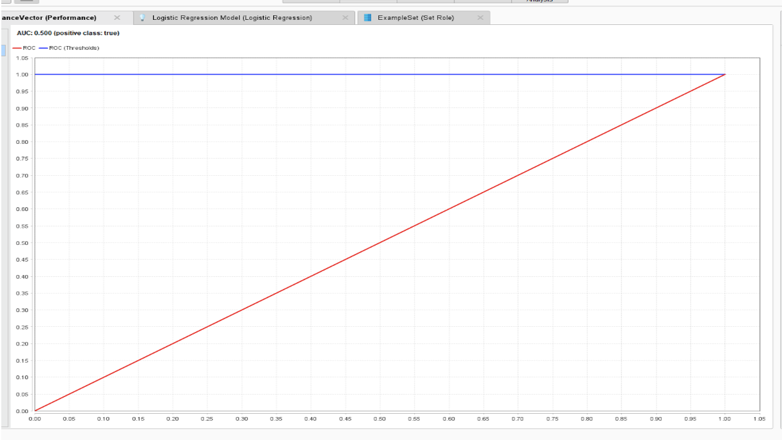
Machine Learning Models
Logistic
REGRESSION
The first model we applied is logistic regression. We aim to use its probabilistic binary classification to predict our target variable. For performance, we choose accuracy, recall, precision and AUC. AUC is equal to 0.5 which is ideal. Accuracy is 23.07.

Slide 8
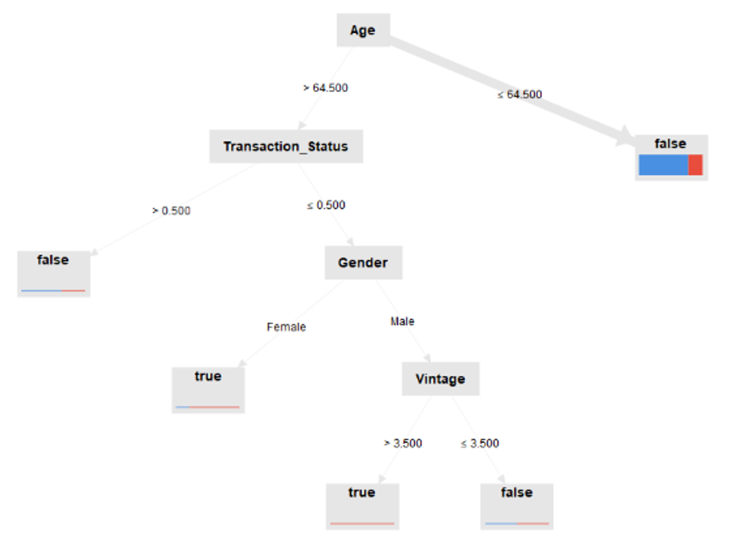
Machine Learning Models
Decision
TREES
We then used the decision trees model. They partition the data into subsets based on the values of input features, creating a tree-like structure. Parameter 5 for maximal depth, 5 for minimal leaf size and 4 for minimal size for split. AUC is again 0.5 (ideal). Accuracy is 76.93 which is more than logistic regression.

Slide 9
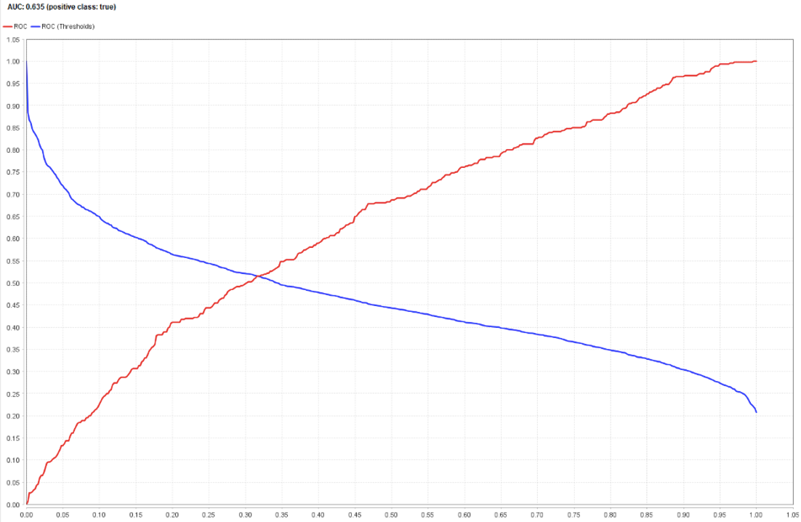
Machine Learning Models
Naive
BAYES
We also used naive bayes on our data. It analyzed the training data to estimate the probability distributions of the features for each class.

Slide 10
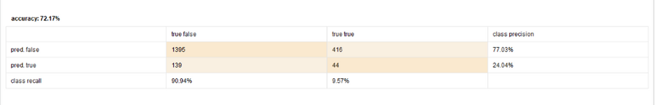
Machine Learning Models
KNN
We then used kNN to find the closest neighbors to a new data point and predict its class or value based on those neighbors. The parameter we used for k=5.

Slide 11
Machine Learning Models
SVM
To find the best separating line or hyperplane between different classes in the data we used SVM operator. It maximizes the margin, the distance between the nearest data points of different classes, making it a robust classifier. The parameter ‘kernel type’ was set to polynomial.

Slide 12
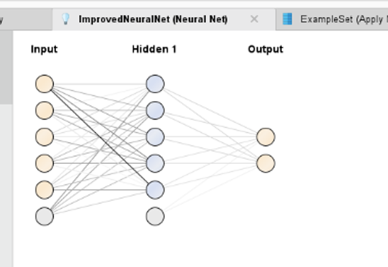
Machine Learning Models
ANN
We applied the ANN model using neural net operator which passes through layers of interconnected neurons, adjusting connections to minimize errors during training, and making predictions or classifications based on the learned patterns.

